Slide 1
Data & Model
Drift Monitoring
What, Why and How to tackle it.

Slide 2
Agenda
Introduction to Drift
Why do ML models drift ?
Types of Drift
How to detect drift ?
Solution

Slide 3

Introduction to Drift
Machine learning models are trained with historical data, but once they are used in the real world, they may become outdated and lose their accuracy over time due to a phenomenon called drift.
Drift is the change over time in the statistical properties of the data that was used to train a machine learning model. This can cause the model to become less accurate or perform differently than it was designed to.

Slide 4
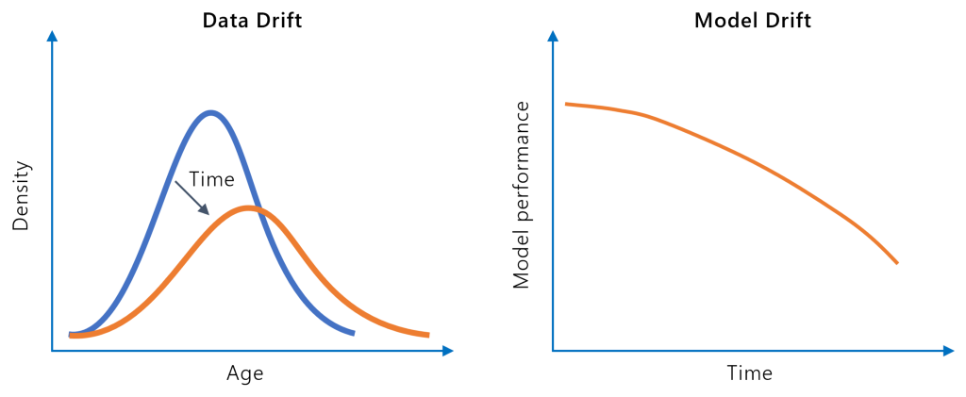
Why do ML Models drift?
Relationship between X and Y changes: If we train the model with data from a stable market, it might do well at first. However, if the market becomes more volatile over time, the model might not be able to accurately predict the stock price anymore because the statistical properties of the data have changed.
Data distribution changes: The input data distribution of the new data changes from the historical data the model was trained upon.

Slide 5
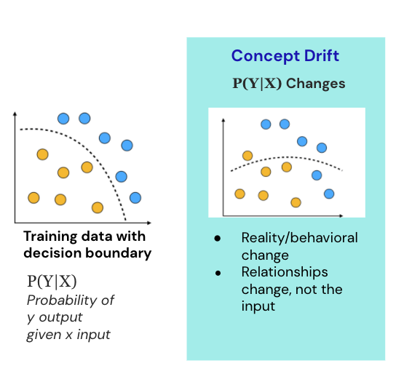
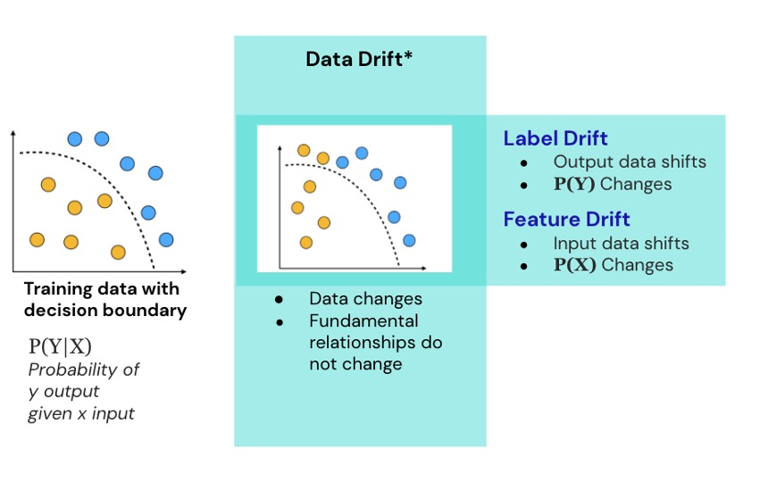
Types of Drift

Slide 6
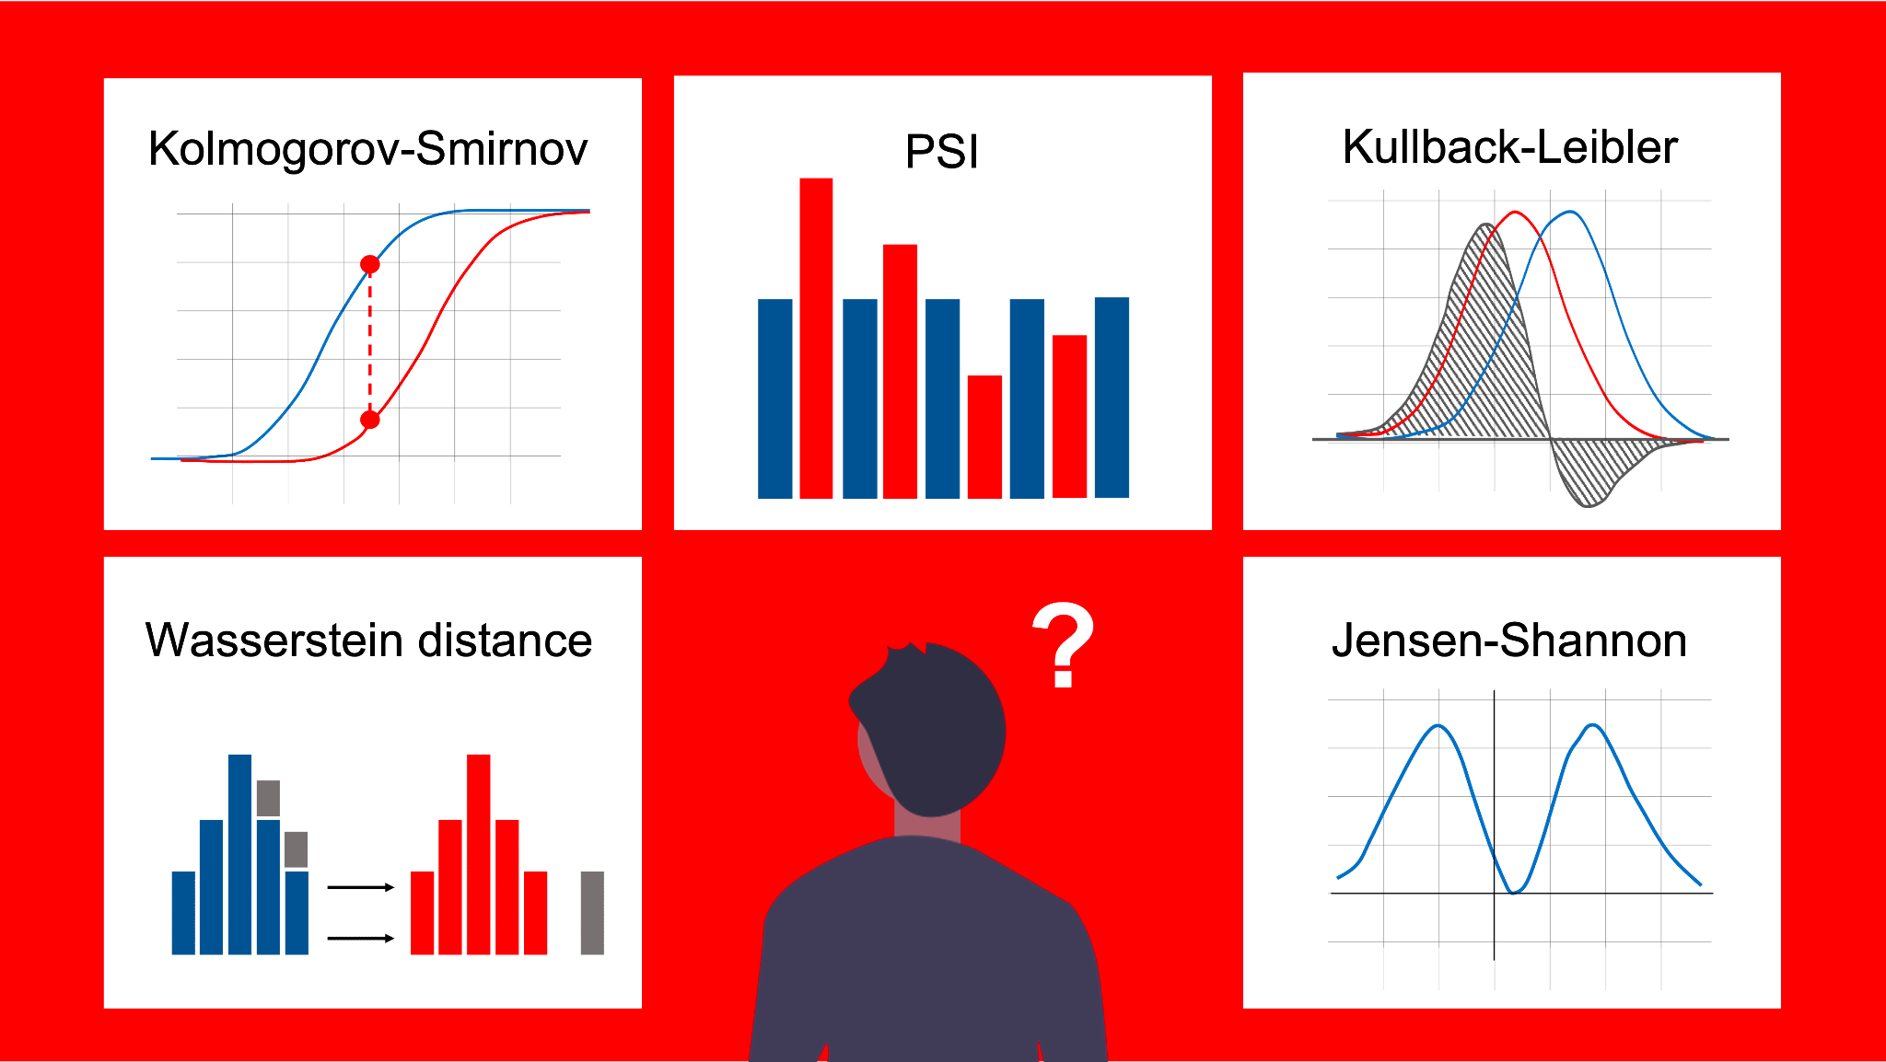
How to detect drift?
Monitor Model Performance metrics - accuracy, recall, F1-Score, ROC-AUC etc.
Monitor Descriptive Statistics.
Monitor Distribution changes using Statistical tests: (below)

Slide 7
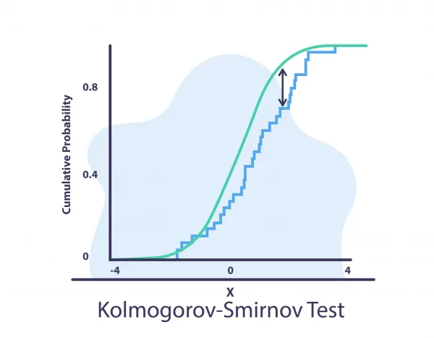
Kolmogorov-Smirnov (K-S) test:
It is a nonparametric statistical test that is used to determine whether two sets of data come from the same distribution. It is often used to test whether a sample of data comes from a specific population or to compare two samples to determine if they come from the same population.
The null hypothesis in this test is that the distributions are the same. If this hypothesis is rejected, it suggests that there is a drift in the model.

Slide 8
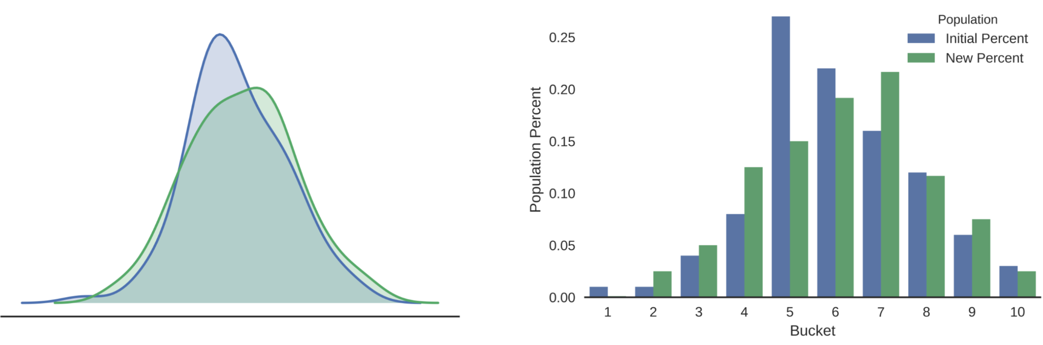
Population Stability Index (PSI)
Population stability Index (PSI) is a model monitoring metric that is used to quantify how much the distribution of a continuous response variable has changed between two given samples, typically collected at different points in time.
A high PSI value indicates that there is a significant difference between the distributions of the variable in the two datasets, which may suggest that there is a drift in the model.

Slide 9
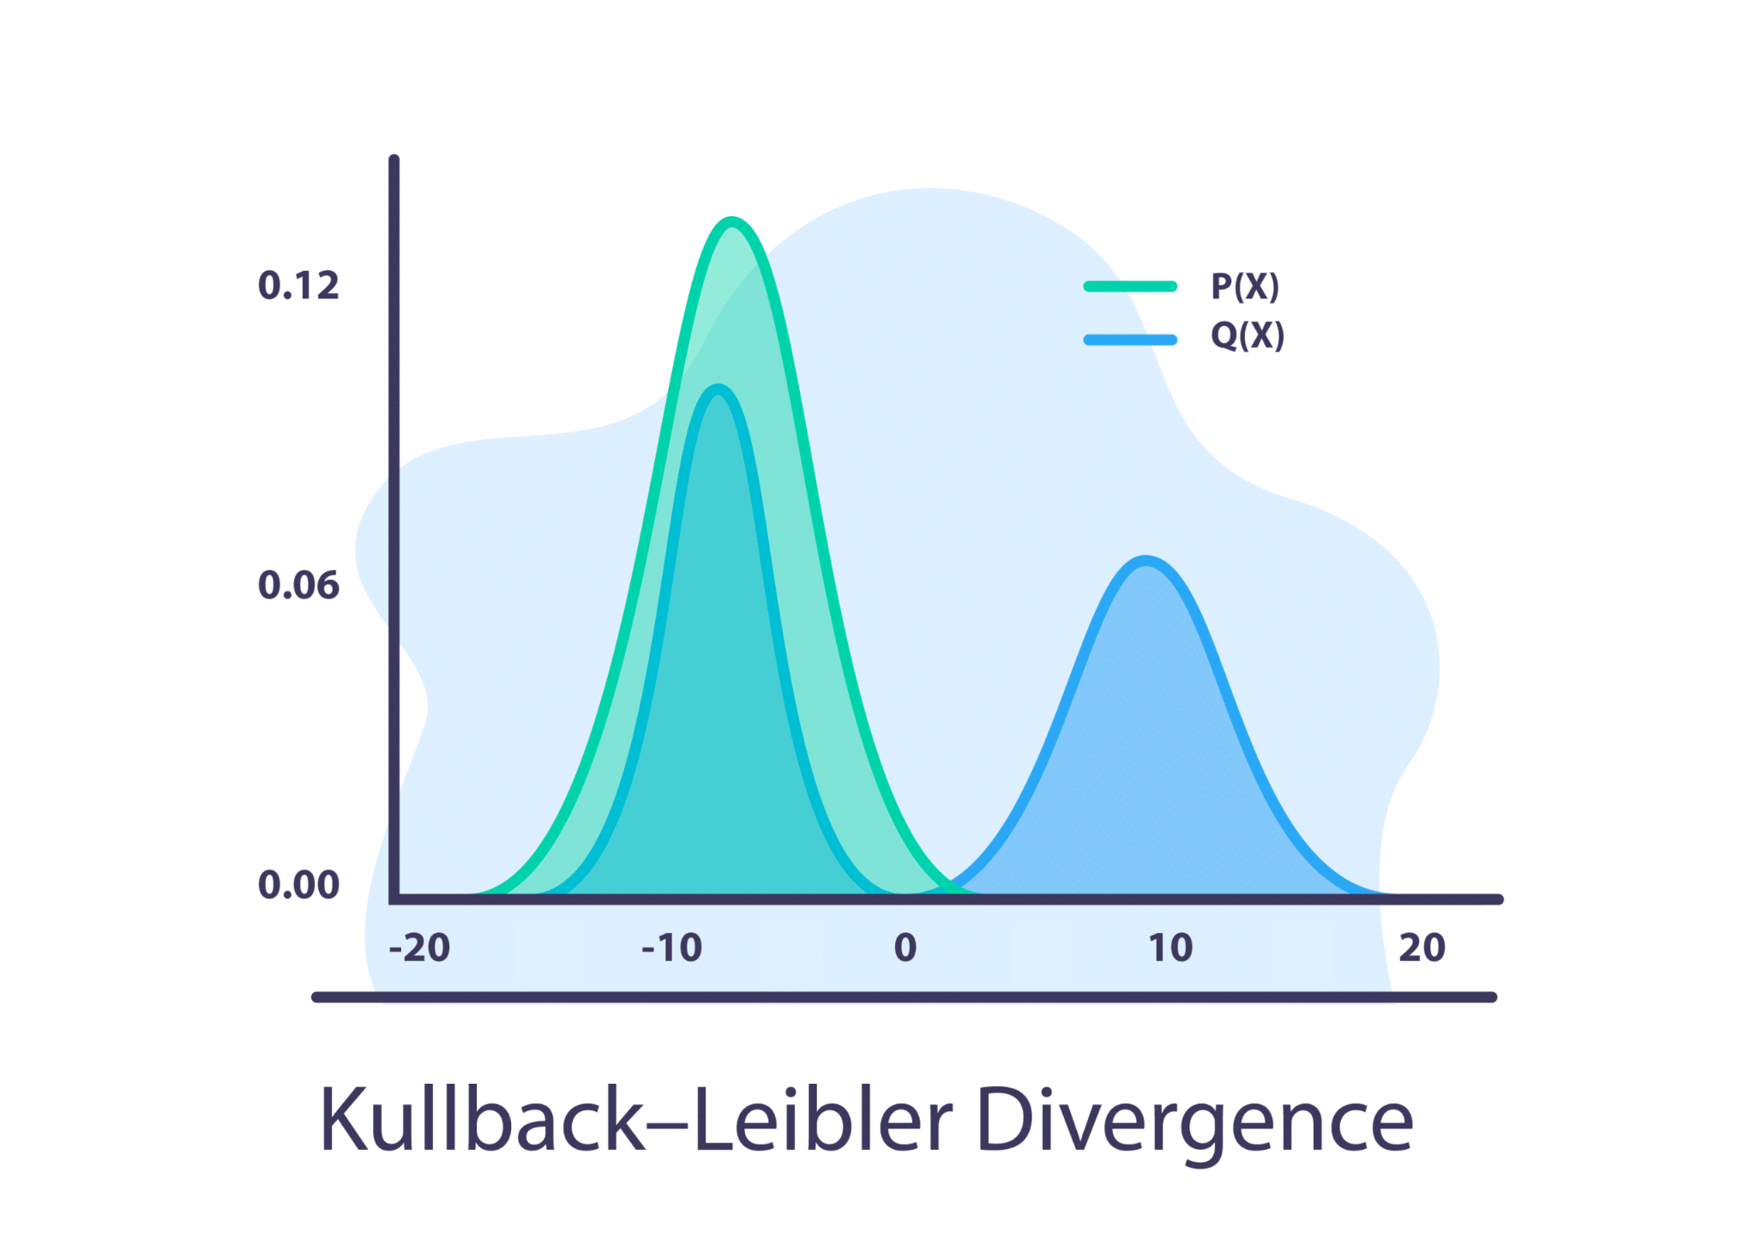
Kullback-Leibler Divergence
The Kullback-Leibler divergence is a measure of the difference between two probability distributions, with a higher divergence indicating a greater degree of difference between the distributions.
If the divergence is above a certain threshold, this could indicate that there is a drift in the data.

Slide 10
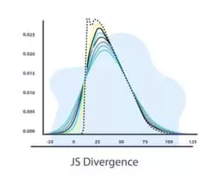
Jensen-Shannon Divergence
It is defined as the average of the Kullback-Leibler divergences between the two distributions and a third distribution that is the average of the two.
The Jensen-Shannon divergence is always non-negative and takes on a value of zero if and only if the two distributions are identical.

Slide 11
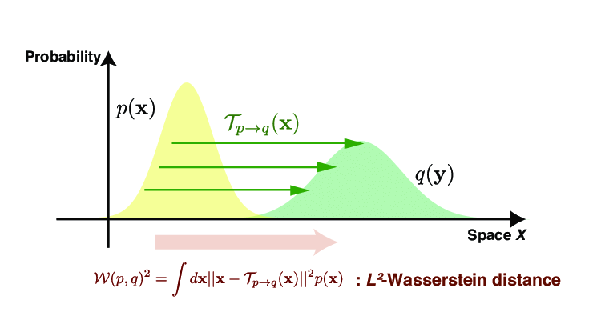
Wasserstein Distance
The Wasserstein distance is a measure of the distance between two probability distributions, with a higher distance indicating a greater degree of difference between the distributions. If the distance is above a certain threshold, this could indicate that there is a drift in the data.
It is important to note that the Wasserstein distance requires the input data to be one-dimensional and non-negative.

